Slide 1



Introduction to MySQL Assignment
Data Scientists Group:
Abdullah Alashmawi Abdullah AlHussain
Halah Almodarra Nourah AlMutlaq
Yasmeen Aldossary

Slide 2


Outline
01
Gender Equality Scenario
02
COVID-19 Scenario
03
Bonuses Scenario

Slide 3
1
Gender Equality Scenario

Slide 4
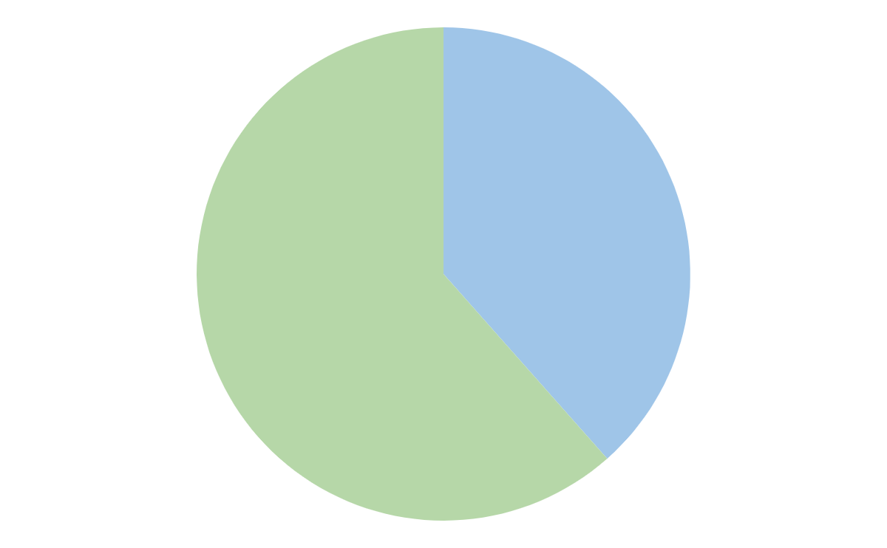
Number of Male and Female Employees in the Company
Female
60%
40%
Male
As we can see 60% of the employees are men while 40% are women which conflicts with gender equality employment policy.

Slide 5

Ratio of Male and Female Employees (Last 5 years)
1.52 : 1
The ratio of males to females hired between 1996-01-01 And 2000-12-31.

Slide 6
Ratio of Male and Female Employees (Last 5 years)
Gender Equality Assessment for each Department
dept_no | dept_name | Num_Of_M | Num_Of_F | The Gap | Ratio M/F | % of increase per year
d005 | Development | 3773 | 2476 | 1297 | 1.52:1 | 1.0879
d004 | Production | 3215 | 2140 | 1075 | 1.5:1 | 1.139
d007 | Sales | 2286 | 1471 | 815 | 1.55:1 | 1.1467
d008 | Research | 962 | 606 | 356 | 1.59:1 | 1.0969
d009 | Customer Service | 1029 | 673 | 356 | 1.53:1 | 1.0889
d003 | Human Resources | 828 | 478 | 350 | 1.73:1 | 1.116
d006 | Quality Management | 912 | 625 | 287 | 1.46:1 | 1.0785
d001 | Marketing | 879 | 597 | 282 | 1.47:1 | 1.0802
d002 | Finance | 734 | 507 | 227 | 1.45:1 | 1.0775

Slide 7
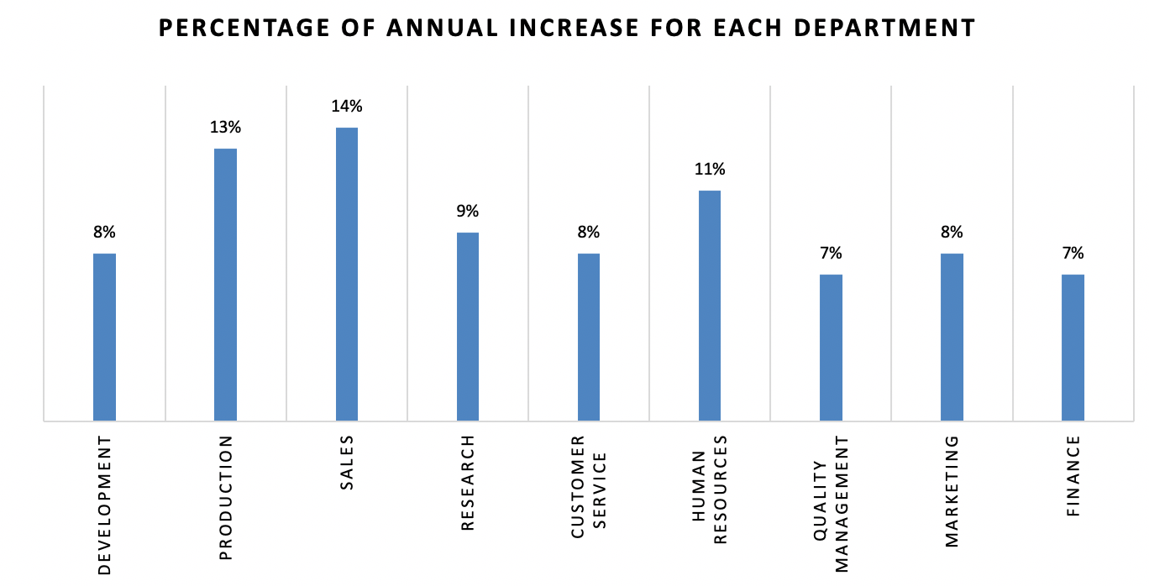
5-Year plan to resolve Gender Equality (2001 - 2005)

Slide 8
5-Year plan to resolve Gender Equality (2001 - 2005)
Year | Development Dept |  | Ratio M/F
 | M | F
2000 | 3773 | 2476 | 1.52:1
2001 | 3962 | 2828 | 1.4:1
2002 | 4160 | 3230 | 1.29:1
2003 | 4368 | 3690 | 1.18:1
2004 | 4586 | 4215 | 1.09:1
2005 | 4815 | 4815 | 1:1

Slide 9
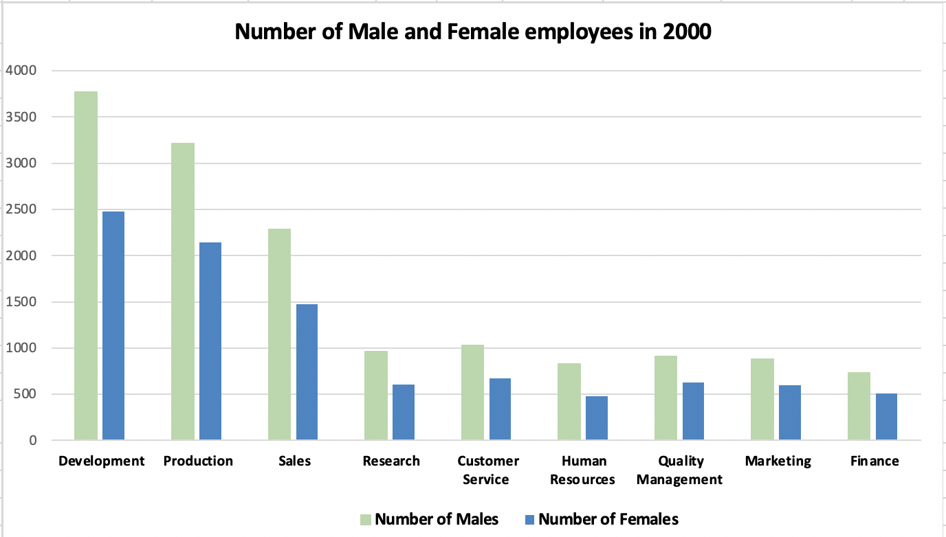
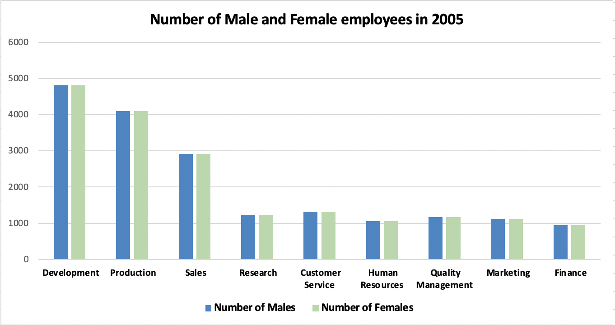
5-Year plan to resolve Gender Equality (2001 - 2005)

Slide 10
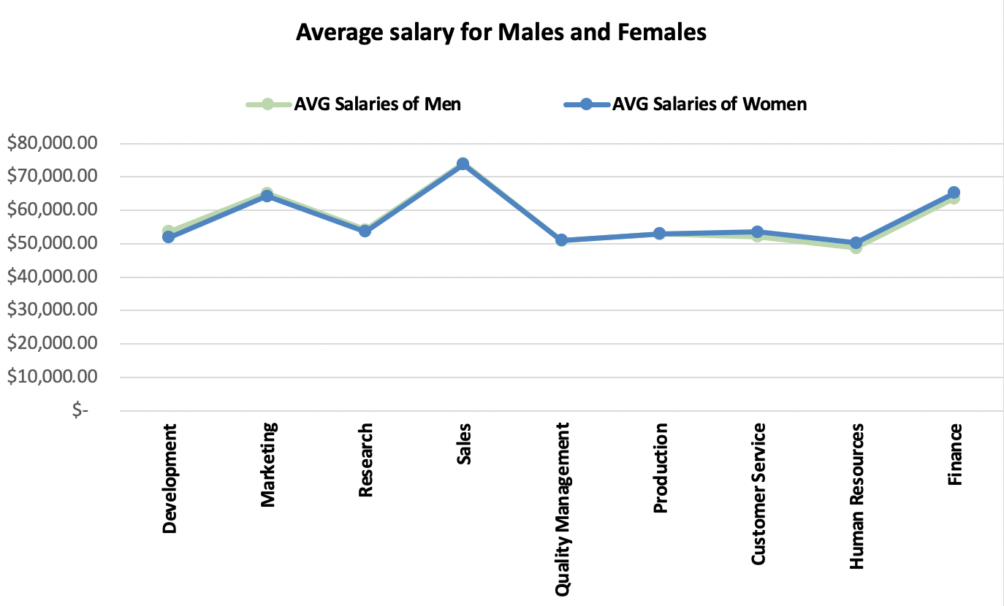
The Average Salary for Males and Females

Slide 11
2
COVID-19 Scenario

Slide 12
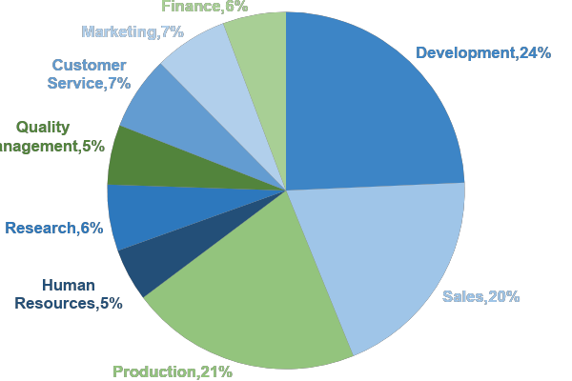
Percentages of salary in each Department
40%
60%

Slide 13
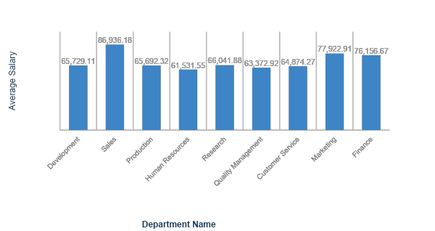
Average Salary in each Department
859
1000
541

Slide 14
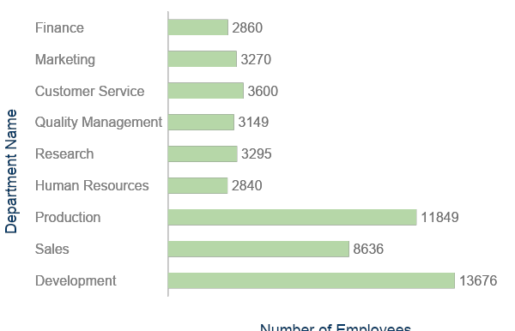
Number of Employees above the average
859
1000
541

Slide 15

Percentage of all contracts expiring within a year (Dec 31, 2001)
2%
Contracts Expiring | 2456 Contracts
Total Contracts | 112555 Contracts
Percentage of all contracts expiring within a year
Total Salary of all contracts expiring within a year = $ 159,961,651

Slide 16



Strategy
Goals
25%
Above Average
Reducing salaries
Below Average
15%
save 20% of the total salaries it pays annually.
$1,574,019,801.6
Pushing employees to early retirements.

Slide 17
3
Bonuses Scenario

Slide 18


Bonuses Project
Budget
Role
$50 millions
Purpose
Due Date
Our role is to design a plan for distributing bonuses
Our company wants to offer bonuses at the end of the year to reward our employees
7 Jan 2001

Slide 19


Project Journey
01
02
03
Gender Equality
Years Of Service
Contracts Will Expire

Slide 20
Gender Equality
The Action
Case 1
The Question
The Action
Case 2
If the average salary for males and females are equal, then we’ll not Do anything.
The answer is yes
Is the average salary for males and females equal?
The answer is no
If the average salary for males and females are not equal, then we will offer a higher bonus.

Slide 21
Gender Equality
The Result
We have calculated the average salaries for females and males, And we found that, there is no significant difference between the average female salaries and the average male salaries in our company.
So, there is no need to give them bonuses.
40%
60%

Slide 22
The Question
01
02
03
Years Of Service
On what basis can we distribute bonuses? depending on the number of years of service.
We calculate the number of years of service for each employee
We have arranged the
employees into three
categories
We clean the data

Slide 23
Years Of Service
Our Plan
0.2%
0.1%
1%
4 to 10 years
Less than 4 years
More than 10 years

Slide 24
$45,804,733
Years Of Service
Total bonuses that we will give to our employees based on the number of years of their service

Slide 25


The Budget
The Plan
Contracts Will Expire
The Question
Is their contracts are expiring soon (February 1, 2001)? And how can we convince them to stay?
$4,195,267
our plan is to offer them 0.07% bonus of their salaries.

Slide 26
Our Final Plan

Slide 27
THANKS
Do you have any questions?

